Slide 2
What is FA?
A didactic approach that focuses on the active role of a pupil.
It involves pupils in all the phases of the learning process, from planning the process to carrying it out and evaluating the progress.
It supports pupils‘ involvement in the learning process, increases their learning motivation and helps them take responsibility for their learning process.

Slide 3
There are different elements that support this approach: establishing prior knowledge, explaining the learning purposes and the criteria for the assessment of the progress, individual planning, developing learning strategies that support individual learning goals, self-assessment, quality feedback, peer review, team work, active learning methods, collaborative learning …

Slide 4
FA history in our school
School year 2017/18 – introductory seminars, literature.
School year 2017/18 – visit to a school in Velenje (observed lessons and FA in practice).
School year 2018/19 – we invited a consultant from The Institute for Education of the Republic of Slovenia (Sonja Zajc) to guide us.
School years 2018/19, 2019/20 – teachers from 1st to 5th grade attended seminars, monthly meetings, performed the so called „learning walks“ (getting familiar with the use of elements of FA in practice).
School year 2019/20 – teachers from 6th to 9th grade joined us.
No action plan for spreading FA among teachers, the progress very slow.
School year 2020/21 – we have a new consultant BUT it‘s Corona time.

Slide 5
Where are we now?
We did a survey to see where we currently stand. Less than half of our staff answered the questions.

Slide 9
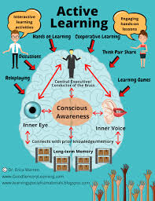
What are in your opinion the advantages of using the elements of FA in your lessons?
Active pupils (9x), taking responsibility for own progress (2x), encouraging responsibility (4x), encouraging independence (3x), offering possibility for self-evaluation, better focus, quality learning, developing inner motivation (5x), developing meta-cognition, developing positive self-esteem (3x), developing positive attitude towards the learning process, encouraging co-operation (2x) and therefore greater interest,

Slide 10
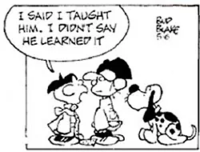
improving learning with quality feedback instead of judgment in the form of an assessment, sustainable knowledge, involving pupils in the learning process (4x), raising awareness of the importance of knowledge, encouraging collaborative learning, raising the feeling of success, encouraging self-initiative (2x), easier achievement of goals, easier progress monitoring (3x), empowerment of pupils and teachers, clarifying learning purpose, raising a sense of self-importance, quality lessons for satisfied pupil, introspection, encouraging thinking, transition from mere explanation to broader meaning of learning.

Slide 11
What in your opinion contributes to a more active role of pupils and to them taking more responsibility for one’s own progress?
Collaborative learning (3x), teacher’s positive attitude (3x), involving pupils in the co-creation of the learning process (2x), the sense of security and acceptance (2), recordings of the execution of tasks, motivation (4x), positive family encouragement (3x), stimulating learning environment, mistakes allowed, respectful relationship, teaching strategies, challenges, peer support, practical work, taking responsibility, good relationship with teachers, possibility of improvement,

Slide 12
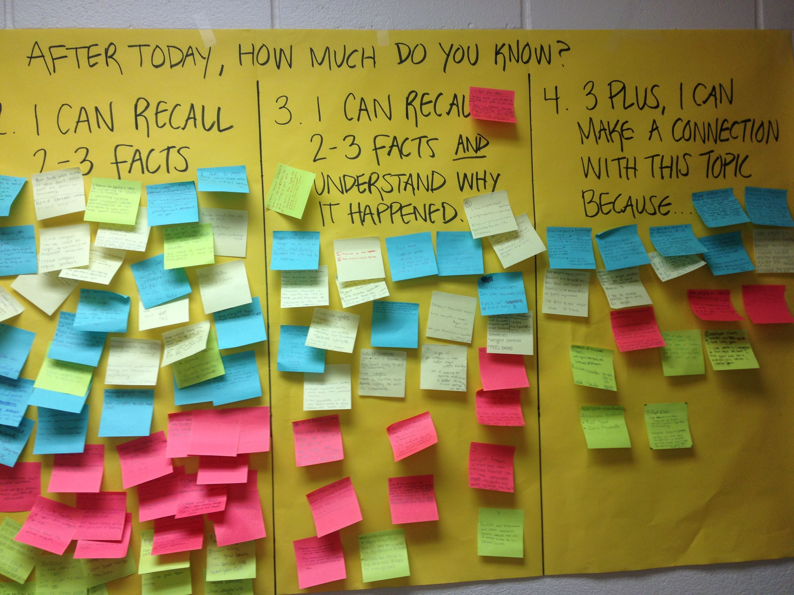
self-evaluation of progress, humour, teacher as a role model (2x), storytelling, methodically well-designed lesson, connection of school matter with everyday life, getting out of the box, creating appropriate circumstances and atmosphere, topic update (2x), teacher’s constant encouragement, curiosity, desire for success, rewarding, family education, team work, praise, research work, problem-based work, awareness of the importance of learning.

Slide 13
What do our pupils have to say?
We did a survey on that as well. 139 pupils from the 8th and the 9th grade answered the questions.

Slide 16
What motivates you the most in your lessons?
Teachers’ explanation (4x), school outside (3x), rewarding (3x), group work (7x), writing (2x), visually supported lessons, distance learning, doing exercise and experimenting (5x), nothing (2x), pair work (2x), playing music during lessons, the teacher, innovative teacher’s explanation (short films, experiments…) (7x), conversation and assessment, teachers using humour and asking questions (we participate more), presenting examples, inter-disciplinary based lessons, practical work (3x),

Slide 17
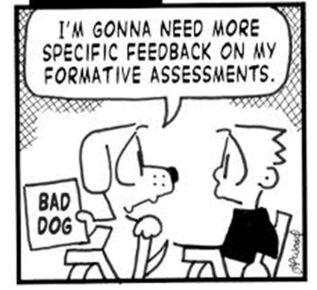
having fun while learning (4x), friendly teachers, storytelling (3x), interesting topics, independent work (managing one’s own time), teacher explaining with a help of a presentation (PowerPoint), fun teachers, doing examples together on the board, quiz, checking homework, explanation-conversation-practical work, learning with ICT, diverse lessons, individual work, energetic teachers help pupils stay focused, research work, useful topics, doing presentations, active learning, conversation, teachers’ support, Zoom meetings.

Slide 18
»The greatest impact on learning is the daily lived experiences of students in classrooms, and that is determined much more by how teachers teach than by what they teach.« Dylan Wiliam

