Slide 1
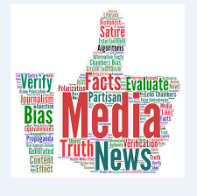
MEDIA LITERACY
OŠ VALENTINA VODNIKA, December 2020

Slide 2
What is media literacy?
Media awareness,
The skill to manage the abundance of information, news in different kinds of media,
The ability of critical thinking applied in media,
Safe use of the internet,
Critical literacy and the ability to filter the information gained on the net,
Knowledge and skills for safe use of social media,
Digital literacy.

Slide 3
Do you use it in your lessons to raise the awareness of your pupils?

Slide 4
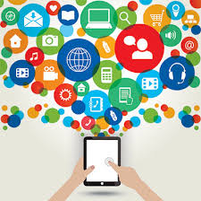
How do you use it in class?
Teaching pupils about media, the function of media, how to distinguish between fake news and credible information,
guiding pupils while searching for different information in various media and establishing the credibility of gained information,
promoting critical thinking,
talking about false news and about how to distinguish the credibility of information,
talking about the safe use of the Internet,
using e-board to demonstrate how to search for information,
raising awareness about social networks.

Slide 5
THANKS FOR YOUR ATTENTION!

